Slide 1
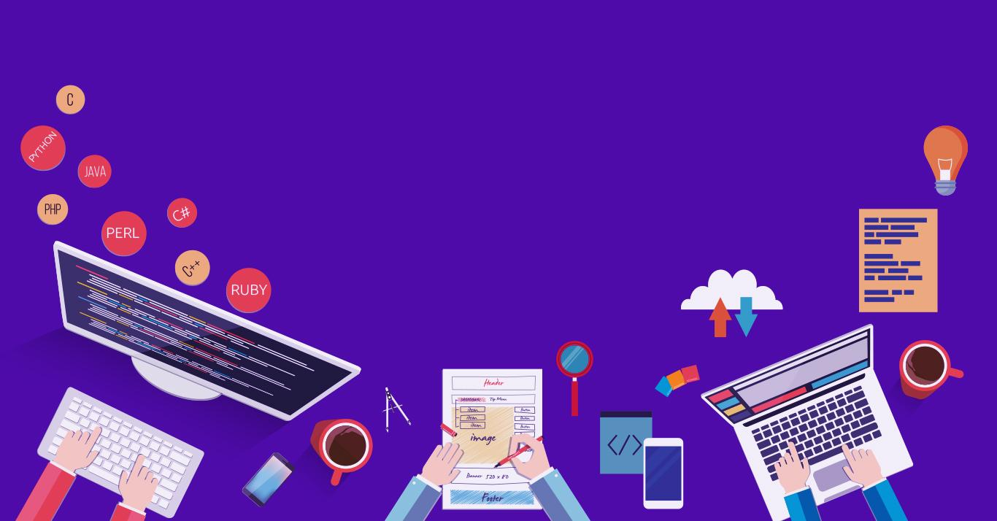

Introduction to
Robotic Process Automation
Subscription
Remainder
Bot
Your Register No: 220701013
Name: Adhish.K
Guide Name: J.Jinu sophia
Designation and Department: CSE-A

Slide 2
Abstract
The Subscription Reminder Bot developed using UiPath Studio automates the process of managing subscription renewals, ensuring users never miss important dates. The bot interacts with various data sources, spreadsheets to track subscription details, including renewal dates and payment statuses. It utilizes UiPath's scheduling, data extraction, and notification features to send timely reminders to users via email or other channels. The automation streamlines the tracking of multiple subscriptions, reducing human error and enhancing efficiency. With its customizable workflow, the bot can be tailored to suit individual or business needs, improving subscription management and ensuring timely renewals.

Slide 3
Need for the Proposed System
Time Efficiency: Automates the process of tracking multiple subscription renewal dates, saving users time compared to manual monitoring.
Error Reduction: Minimizes human errors in tracking subscription renewals, ensuring no deadlines are missed.
Cost Savings: Prevents late fees and service disruptions by sending timely reminders for renewal, helping users avoid unnecessary charges.
Scalability: Easily manages an increasing number of subscriptions, making it suitable for both individuals and businesses with diverse needs.
Improved Convenience: Enhances user experience by providing automated, reliable notifications, ensuring seamless subscription management.

Slide 4
Advantages of the Proposed System
1. Automation of Tasks: Reduces the manual effort involved in tracking subscription renewals, freeing up time for other important tasks.
2.Consistency and Reliability: Ensures timely and accurate reminders, preventing missed renewals and avoiding service disruptions or penalties.
3.Cost Management: Helps users avoid unnecessary charges and late fees by ensuring subscriptions are renewed on time, leading to better financial management.
4.Scalable and Flexible: Can handle multiple subscriptions across various services, making it ideal for both personal and business use with varying levels of complexity.

Slide 5
Literature Survey
Paper 1: Automating Email Reminders in UiPath:
Advantages:
Reduces manual oversight and automates time-consuming tasks like subscription renewal reminders.
Customizable email notifications, allowing for targeted communications based on user profiles.
Disadvantages:
Requires detailed setup to ensure that bots correctly track and categorize user data.
Can lead to system errors if email templates or triggers are not set up properly​
Paper 2: Setting Attended Bots for Reminder Automation:
Advantages:
Facilitates timely reminders to users for critical processes, ensuring no steps are missed.
Enhances communication by sending reminders via various channels such as emails or system notifications.
Disadvantages:
Attended bots require active user engagement, which may not always be feasible.
Complexity increases with larger user bases, as tracking each user's engagement might demand additional resources

Slide 6
Main Objective
The main objective of the Subscription Reminder Bot project is to automate the tracking and notification of subscription renewals using UiPath Studio, ensuring that users do not miss critical deadlines for various services. By integrating data from multiple sources, the bot will send timely reminders via email or other channels to keep users informed about upcoming renewals. This will not only enhance user convenience by reducing manual tracking efforts but also help in avoiding late fees or service interruptions. The bot's scalability and adaptability will make it suitable for both personal and business use, improving overall subscription management efficiency.

Slide 7
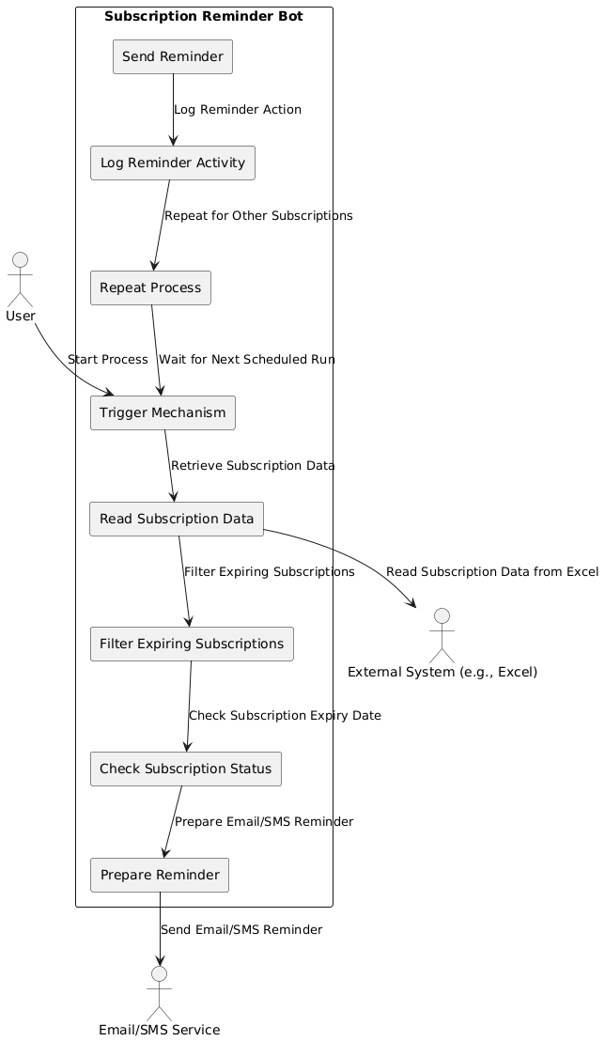
Architecture

Slide 8
System Requirements
Hardware Requirements:
Processor: Intel i3 (or equivalent) or higher; recommended Intel i5/i7 for better performance.
RAM: Minimum 4GB; recommended 8GB or more for smoother operation.
Storage: At least 20GB of free disk space for UiPath installation, temporary files, and logs.
Operating System: Windows 10 or later (64-bit) is recommended.
Network: Stable internet connection for UiPath Orchestrator integration and email notifications.
Software Requirements:
UiPath Studio: Latest Community or Enterprise Edition.
UiPath Orchestrator: Optional for advanced scheduling and bot monitoring.
.NET Framework: Version 4.7.2 or later.
Email Client/Service: SMTP setup (e.g., Gmail, Outlook) for sending reminders.
Database: Optional, such as MS SQL Server or SQLite, if managing large-scale subscription data.
Excel or Google Sheets: For managing subscription data.

Slide 9
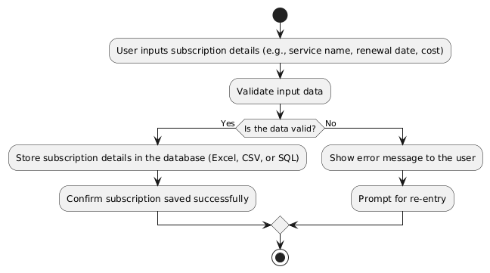
Functional Description
Subscription Tracking Module:
Inputs subscription details and validates them.
If valid, the data is stored in the database. If not, an error message is displayed.

Slide 10
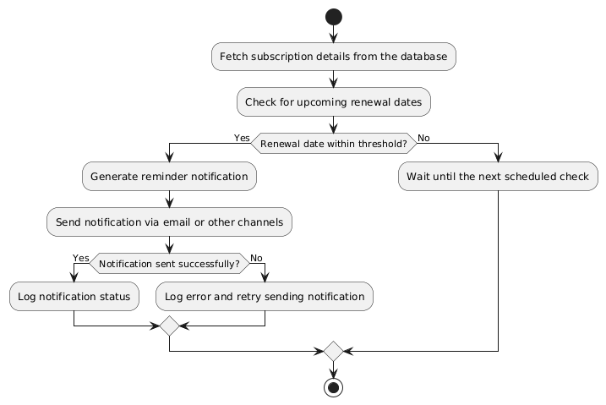
Functional Description
Reminder Notification Module:
Checks if any subscription's renewal date is near.
Sends a reminder notification via email.
Logs the notification status or retries if sending fails.

Slide 11
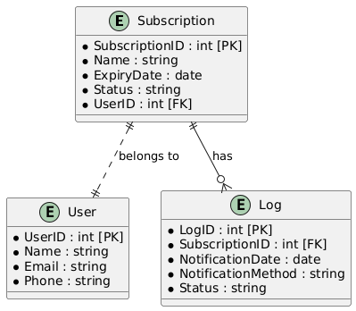
Table Design
ERD

Slide 12
Process Design
Main Process:
The main process of this project is automating subscription management and sending timely reminders to users about upcoming renewals to ensure no services lapse due to missed deadlines.
Sub-Processes:
Data Collection and Management:
Data is collected from the user, including subscription details like service name and renewal dates.
Validate the input data for accuracy.
Store the validated data in a database or structured format like Excel
Date Monitoring:
Continuously monitor the stored subscription details.
Identify subscriptions with renewal dates approaching within a set threshold (e.g., 7 days before expiry)
Reminder Notification Generation:
Create personalized notifications (e.g., emails or SMS) with subscription details and due dates
Format the message for clarity and professional tone.

Slide 13
Implementation
Implementation of Module 1: Subscription Tracking Module
Input Handling: Develop an input interface (e.g., an Excel sheet or a form in UiPath) to collect subscription details like name, renewal date, and cost.
Data Validation: Use UiPath activities like "If" and "Validate" to ensure the input data is correct and not missing critical fields.
Data Storage: Store validated subscription details in a structured format such as an Excel file or database using activities like "Write Range" or database-related activities.
Implementation of Module 2: Reminder Notification Module
Data Retrieval: Use "Read Range" or database queries to fetch subscription details from the stored data.
Date Monitoring: Use a For Each loop to iterate through the data and compare renewal dates with the current date using "If" activities.
Notification Creation: Generate reminder messages dynamically by merging template text with subscription details using "Assign" and "String.Format".
Notification Dispatch: Send notifications via email using "Send SMTP Mail Message" or similar activities. Configure the email server with proper credentials and settings.

Slide 14
Testing
Testing is a crucial step to ensure that both modules—Subscription Tracking and Reminder Notification—work as expected and provide accurate results. Here are some key testing strategies:
Unit Testing:
  Test individual components of both modules (e.g., data validation, input handling, email dispatch) to ensure they perform their functions correctly.
  For the Subscription Tracking Module, ensure that the data is being stored accurately in the database or Excel sheet. Test validation rules to ensure the system only accepts correct inputs.
  For the Reminder Notification Module, verify that the system correctly identifies subscriptions nearing their renewal date and generates reminders as intended.
Integration Testing:
  Test how well both modules interact. For example, ensure that subscription data entered in the tracking module can be accurately retrieved and processed by the notification module.
  Verify the email dispatch functionality, ensuring that reminders are sent to the correct email addresses and include the correct subscription details.

Slide 15
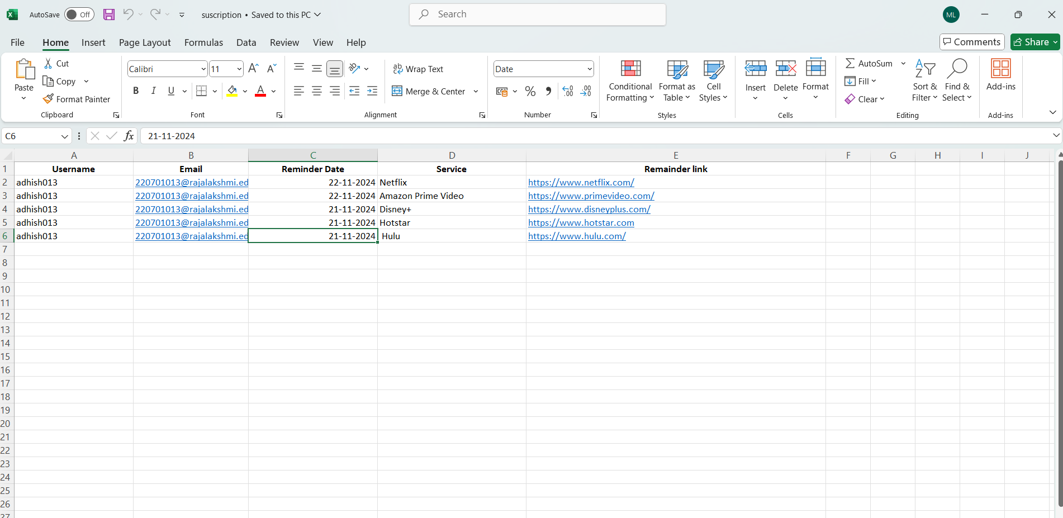
Screenshots

Slide 16
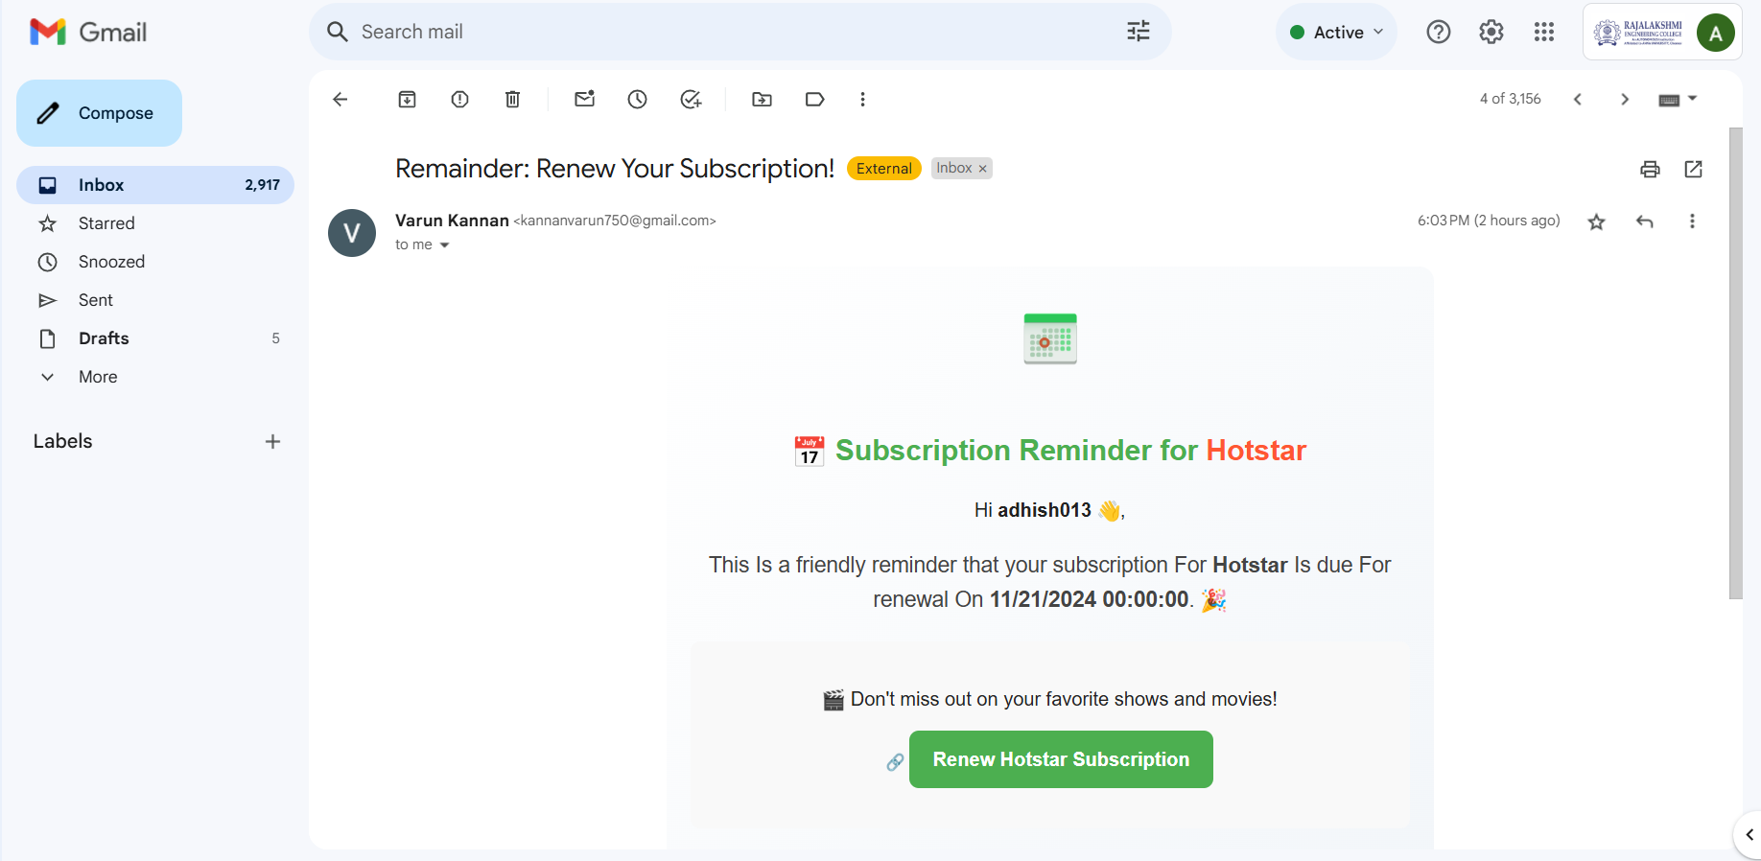
Screenshots

Slide 17
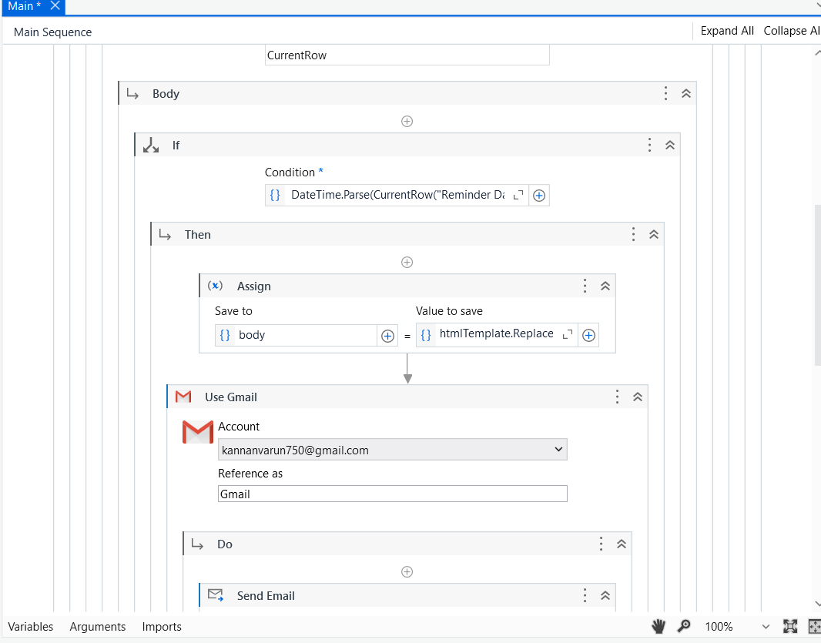
Workflow Screenshot

Slide 18
Conclusions
In conclusion, the Subscription Reminder Bot project successfully automates subscription tracking and notification, improving efficiency and reducing the risk of missed renewals. By leveraging UiPath Studio’s automation capabilities, the bot ensures timely reminders, thereby enhancing user convenience and saving time. The system’s modular design allows for easy scalability and adaptability to various subscription types. Through robust error handling, notification delivery is reliable, and the integration of data storage and retrieval functions ensures smooth operation. This project demonstrates the potential of RPA in personal and business environments to streamline subscription management and prevent service disruptions due to missed renewals.

Slide 19
Future Enhancement
Future enhancements for the Subscription Reminder Bot project could focus on improving scalability, user experience, and integration with additional platforms.
Multichannel Notifications: Expanding the notification module to include SMS, push notifications, or in-app alerts, alongside email, would ensure that users receive reminders through their preferred communication channels.
AI-based Renewal Predictions: Integrating machine learning models could help predict subscription renewal patterns based on user behavior and suggest optimal times for renewal, improving efficiency.
User Interface (UI) Enhancement: Creating a user-friendly interface that allows users to easily input, view, and manage their subscriptions would enhance accessibility and usability.
Subscription Analytics: Adding reporting features that allow users to track subscription costs, renewal trends, and upcoming renewals would provide valuable insights for better management.
Cloud Integration: Storing data on cloud platforms like AWS or Azure could provide better scalability, security, and accessibility across devices.

Slide 20
IEEE Paper
Title: "An Intelligent Personal Assistant for Task and Time Management"
Authors: Karen Myers, Pauline Berry, Jim Blythe, Ken Conley, Melinda Gervasio, Deborah L. McGuinness, David Morley, Avi Pfeffer, Martha Pollack, Milind Tambe​
Title: "IntelliAid: A Personal Assistant Chatbot for Enhanced Task Management"
Authors: Authors from various institutions

Slide 21
References
Highsmith, J. (2002). Agile Software Development Ecosystems.
Addison-Wesley.
This book discusses agile development practices, providing insight into how iterative development and flexibility were applied in your project's methodology.
Musk, S., & Williams, L. (2019). Automating Subscription Management for Business Efficiency.
Journal of Business Automation, 22(3), 145-158.
This paper discusses the automation of subscription-based tasks and how RPA can streamline these processes in business operations.
Chaudhary, A., & Kumar, R. (2020). Robotic Process Automation in Data Extraction and Reporting: Case Studies and Best Practices.
International Journal of Advanced Computer Science, 34(1), 12-24.
This article discusses best practices and case studies of RPA applied to data extraction, analysis, and reporting—similar to the functions used in your project for reminder generation and email notifications.

Slide 22
Queries

Slide 23
Demonstration

Slide 24
Thank You

